Slide 1
MRI Homework1
報告者：王韵雯
日期：2015/10/27

Slide 2
Outline
Software
Intro Practical
Registration Practical

Slide 3
Software
VMware Player 12.0.0
Ubuntu 15.04
FSL

Slide 4
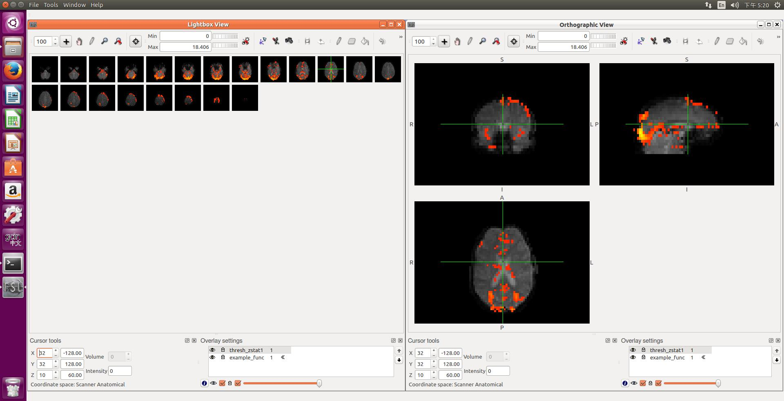
Intro Practical (1)

Slide 5
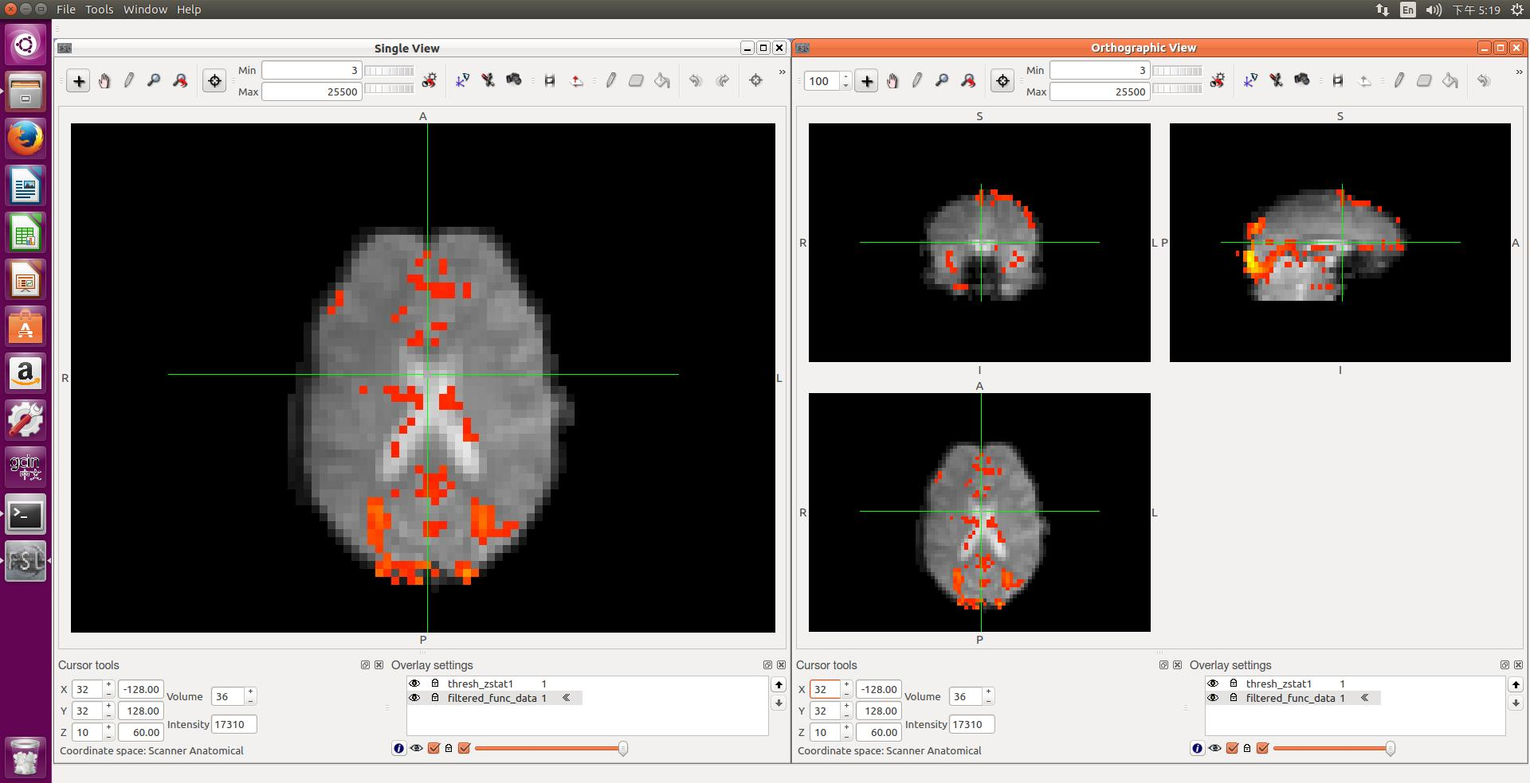
Intro Practical (2)

Slide 6
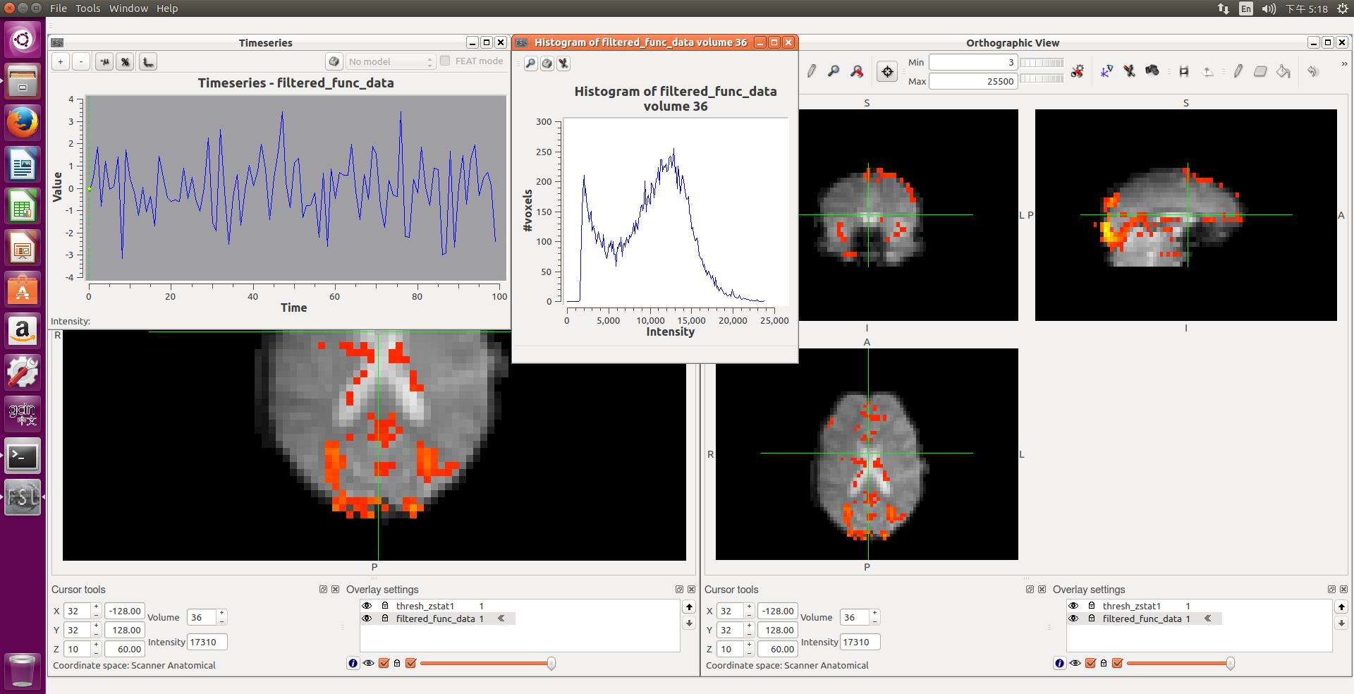
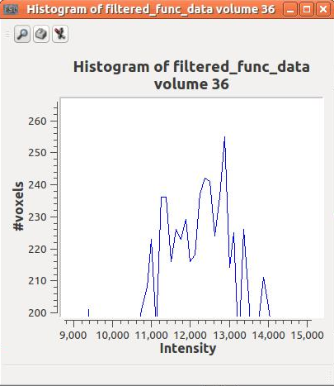
Intro Practical (3)

Slide 7
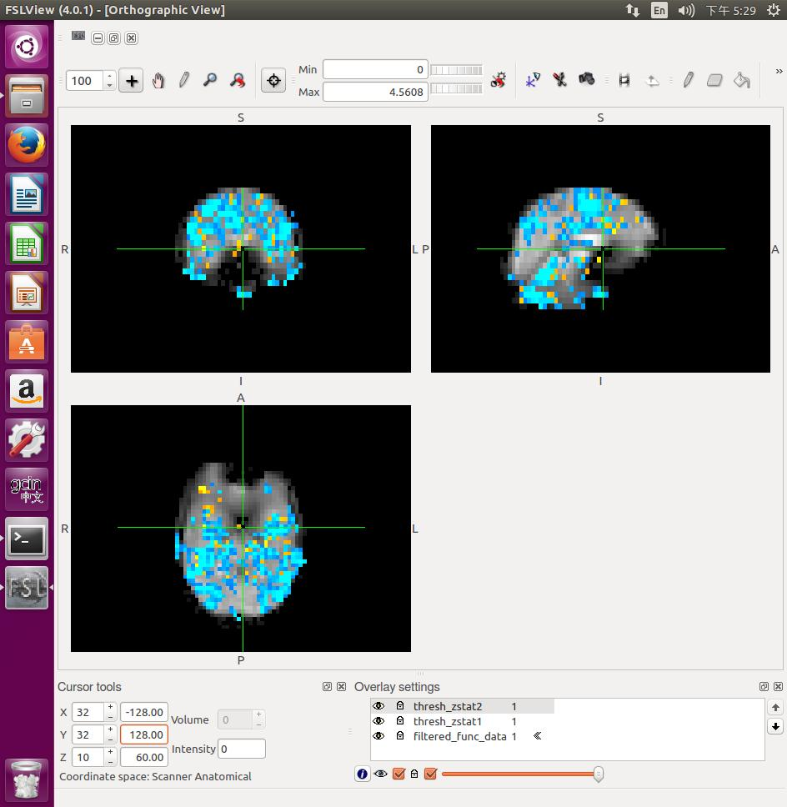
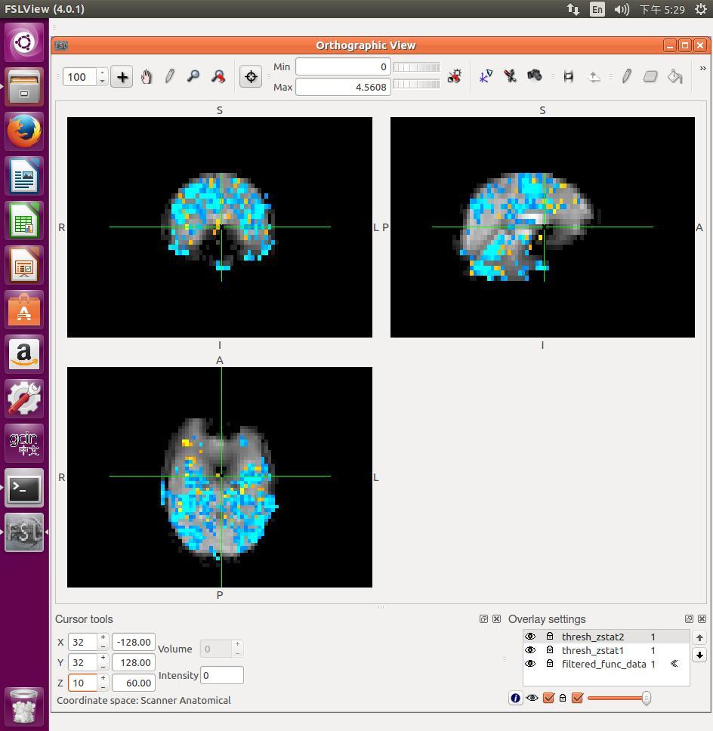
Intro Practical (4)

Slide 8
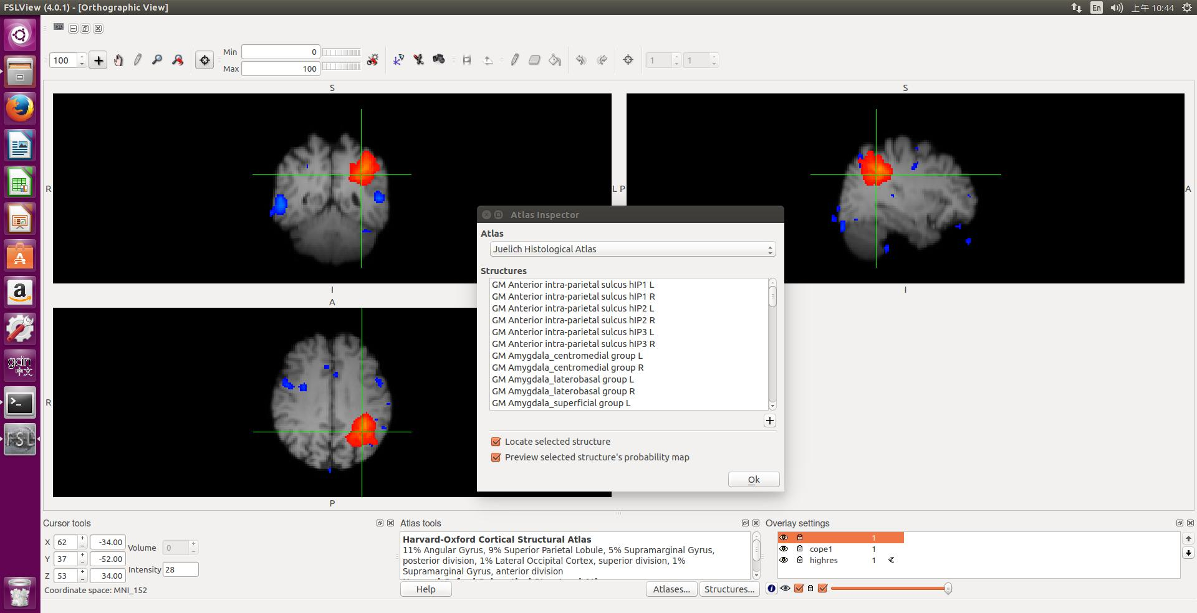
Intro Practical (5)

Slide 9
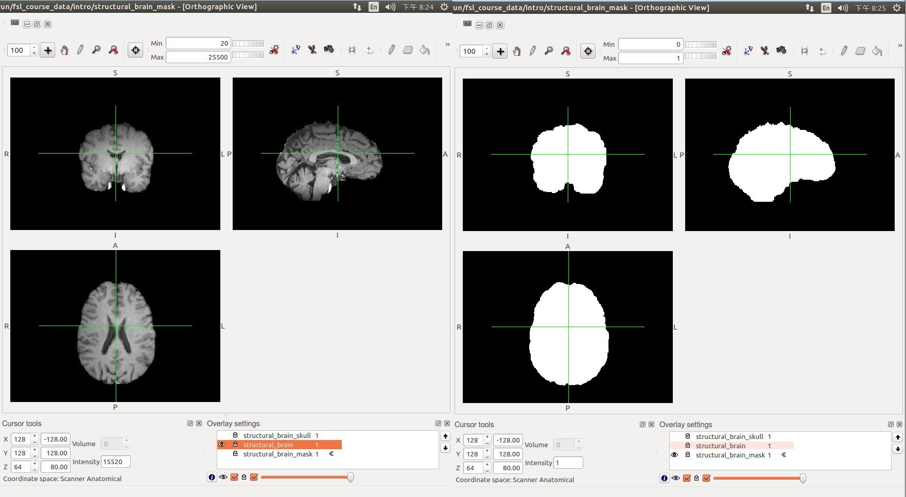
Intro Practical (6)

Slide 10
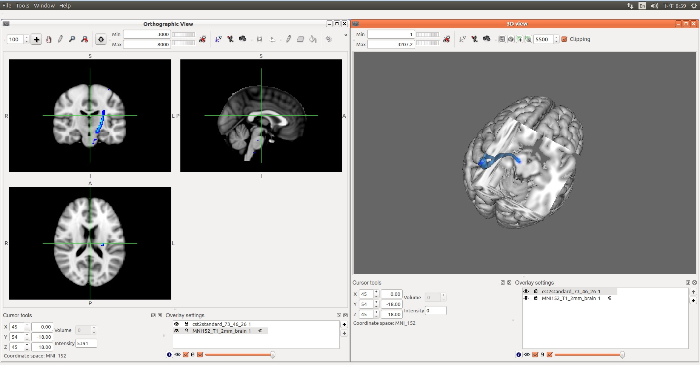
Intro Practical (7)

Slide 11
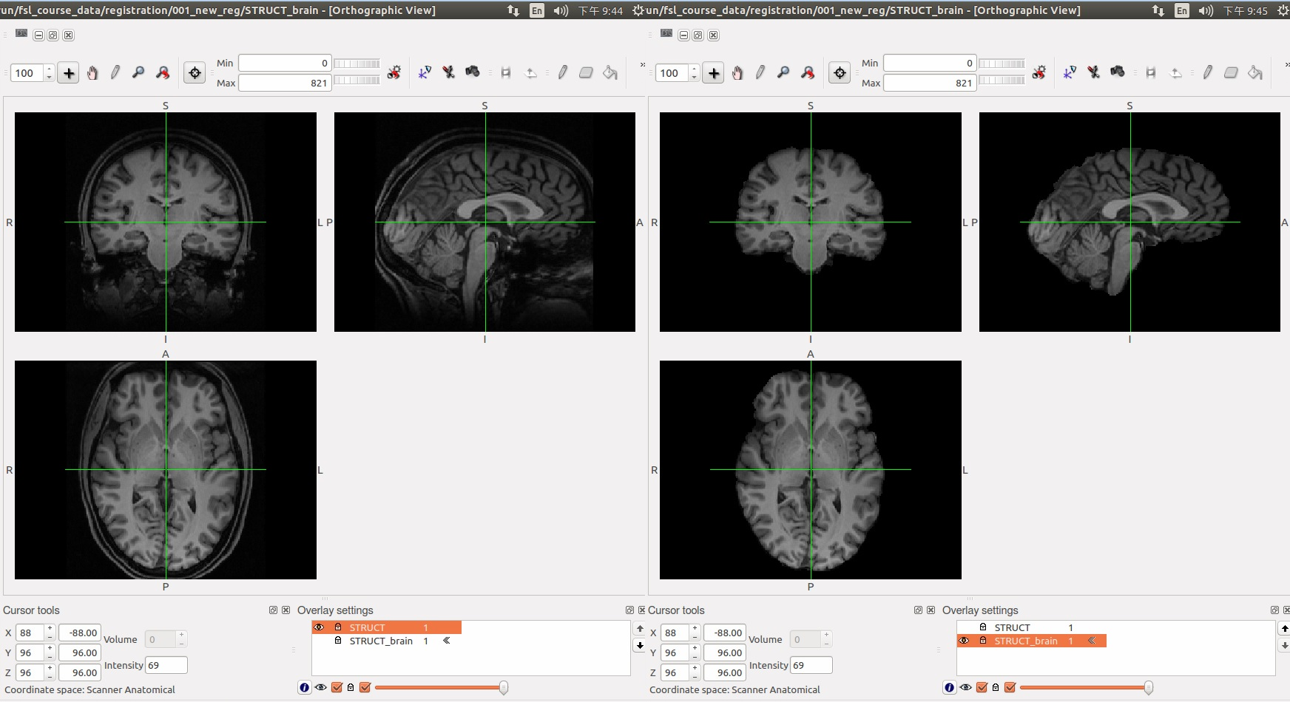
Registration Practical (1)

Slide 12
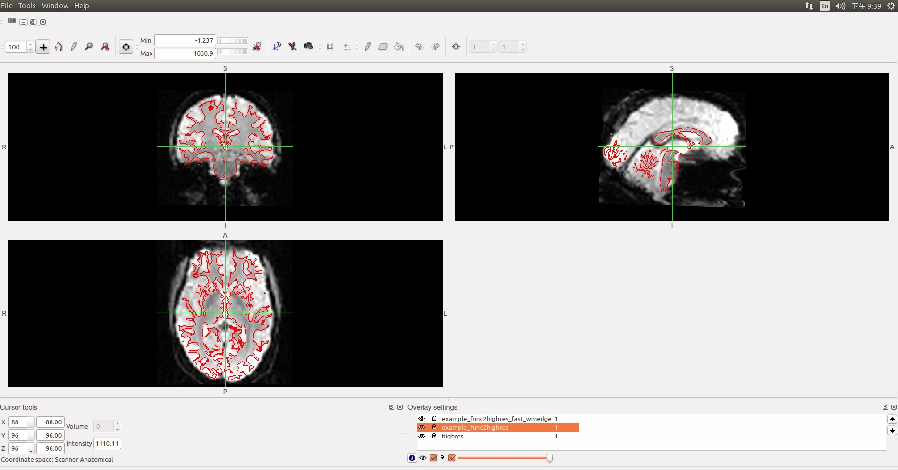
Registration Practical (2)

Slide 13
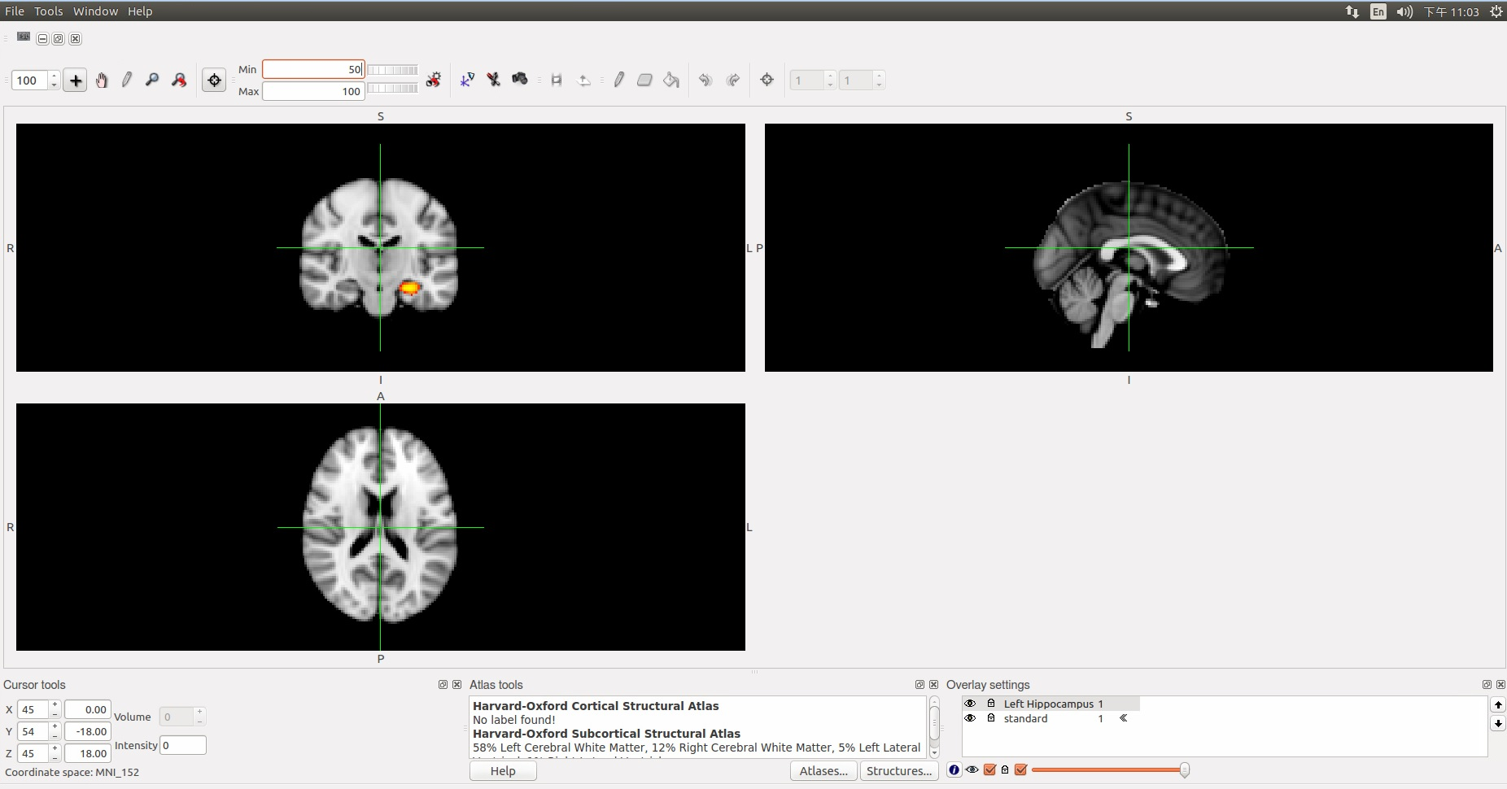
Registration Practical (3)

Slide 14
The End
Thank you for your attention

